Slide 1
Introduction of Medical Natural Language Processing
ZuoFeng Li
Principal Scientist,
Biomedical informatics, Philips Research China – BigData & AI
Hui Zong
Department of Bioinformatics,
School of Life Sciences and Technology, Tongji University

Slide 2
Outline
MedNLP in English
MedNLP in Chinese
Experiment

Slide 3
目录
英文医学自然语言处理
中文医学自然语言处理
实验环节

Slide 4
NLP & MNLP
Natural language processing (NLP) is a subfield of computer science, information engineering, and artificial intelligence concerned with the interactions between computers and human (natural) languages, in particular how to program computers to process and analyze large amounts of natural language data.
-Wikipedia
MedNLP: how to program computers to process and analyze large amounts of medical natural language data.

Slide 5
自然语言处理 & 医学自然语言处理
自然语言处理（NLP）是计算机科学，信息工程和人工智能的子领域，涉及计算机和人类（自然）语言之间的交互，特别是如何对计算机进行编程以处理和分析大量自然语言数据。
-Wikipedia
医学自然语言处理: 如何对计算机进行编程以处理和分析大量医学自然语言数据。.

Slide 6
Timeline of NLP development
Pretrained
language
models
1971-1993
low development
Neural networks
for NLP
-1956
original
Attention
Multi-task learning
2001
2013
2014
2015
1994-
development
2008
2013
2015
2018
1957-1970
rapid development
Sequence-to-sequence models
Neural-language models
Word
embeddings
Memory-based networks
Notes:
自然语言处理的发展历程
萌芽期(1956年以前)
快速发展期(1957-1970)
低速的发展期(1971 -1993)
复苏融合期(1994年至今)
2001年 - 神经语言模型（Neurallanguage models） 2008年 - 多任务学习 Multi-tasklearning） 2013年 - Word嵌入Word embeddings
2013年 - NLP的神经网络Neural networks for NLP
2014年 - 序列到序列模型Sequence-to-sequence models
2015年 - 注意力机制Attention
2015年 - 基于记忆的神经网络Memory-based networks
2018年 - 预训练语言模型Pretrained language models
https://www.jianshu.com/p/284a153c1cd6

Slide 7
自然语言处理发展时间线
预训练
语言模型
1971-1993
低速发展期
NLP的神经网络
-1956
萌芽期
注意力机制
多任务学习
2001
2013
2014
2015
1994-
复苏融合期
2008
2013
2015
2018
1957-1970
快速发展期
序列到序列模型
神经语言模型
Word嵌入
基于记忆的神经网络
Notes:
自然语言处理的发展历程
萌芽期(1956年以前)
快速发展期(1957-1970)
低速的发展期(1971 -1993)
复苏融合期(1994年至今)
2001年 - 神经语言模型（Neurallanguage models） 2008年 - 多任务学习 Multi-tasklearning） 2013年 - Word嵌入Word embeddings
2013年 - NLP的神经网络Neural networks for NLP
2014年 - 序列到序列模型Sequence-to-sequence models
2015年 - 注意力机制Attention
2015年 - 基于记忆的神经网络Memory-based networks
2018年 - 预训练语言模型Pretrained language models
https://www.jianshu.com/p/284a153c1cd6

Slide 8
NLP sub-problems
Low-level NLP tasks include:
Sentence boundary detection
Tokenization
Part-of-speech assignment to individual words (‘POS tagging’)
Morphological decomposition of compound words
Shallow parsing (chunking)
Problem-specific segmentation
High-level NLP tasks include:
Spelling/grammatical error identification and recovery
Named entity recognition (NER)
Nadkarni P M , Ohno-Machado L , Chapman W W . Natural language processing: an introduction[J]. Journal of the American Medical Informatics Association, 2011, 18(5):544-551.
Notes:
Sentence boundary detection: abbreviations and titles (‘m.g.,’ ‘Dr.’) complicate this task, as do items in a list or templated utterances (eg, ‘MI [x], SOB[]’)
Tokenization: identifying individual tokens (word, punctuation) within a sentence. A lexer plays a core role for this task and the previous one. In biomedical text, tokens often contain characters typically used as token boundaries, for example, hyphens, forward slashes (‘10 mg/day,’ ‘N-acetylcysteine’).
Part-of-speech assignment to individual words (‘POS tagging’): in English, homographs (‘set’) and gerunds (verbs ending in ‘ing’ that are used as nouns) complicate this task.
Morphological decomposition of compound words: many medical terms, for example, ‘nasogastric,’ need decomposition to comprehend them.
Shallow parsing (chunking): identifying phrases from constituent part-of-speech tagged tokens. For example, a noun phrase may comprise an adjective sequence followed by a noun.
Problem-specific segmentation: segmenting text into meaningful groups, such as sections, including Chief Complaint, Past Medical History, HEENT, etc
Spelling/grammatical error identificationand recovery: this task is mostly interactive because, as word-processing users know, it is far from perfect. Highly synthetic phrases predispose to false positives (correct words flagged as errors), and incorrectly used homophones (identically sounding, differently spelled words, eg, sole/soul, their/there) to false negatives.
Named entity recognition (NER)26,27: identifying specific words or phrases (‘entities’) and categorizing them—for example, as persons, locations, diseases, genes, or medication.

Slide 9
自然语言处理-子任务
Low-level NLP tasks include:
句子边界检测
符号化
对单个单词的词性标注
复合词的形态分解
浅解析（分块）
特定问题的细分
High-level NLP tasks include:
拼写/语法错误识别和恢复
命名实体识别（NER）
Nadkarni P M , Ohno-Machado L , Chapman W W . Natural language processing: an introduction[J]. Journal of the American Medical Informatics Association, 2011, 18(5):544-551.
Notes:
Sentence boundary detection: abbreviations and titles (‘m.g.,’ ‘Dr.’) complicate this task, as do items in a list or templated utterances (eg, ‘MI [x], SOB[]’)
Tokenization: identifying individual tokens (word, punctuation) within a sentence. A lexer plays a core role for this task and the previous one. In biomedical text, tokens often contain characters typically used as token boundaries, for example, hyphens, forward slashes (‘10 mg/day,’ ‘N-acetylcysteine’).
Part-of-speech assignment to individual words (‘POS tagging’): in English, homographs (‘set’) and gerunds (verbs ending in ‘ing’ that are used as nouns) complicate this task.
Morphological decomposition of compound words: many medical terms, for example, ‘nasogastric,’ need decomposition to comprehend them.
Shallow parsing (chunking): identifying phrases from constituent part-of-speech tagged tokens. For example, a noun phrase may comprise an adjective sequence followed by a noun.
Problem-specific segmentation: segmenting text into meaningful groups, such as sections, including Chief Complaint, Past Medical History, HEENT, etc
Spelling/grammatical error identificationand recovery: this task is mostly interactive because, as word-processing users know, it is far from perfect. Highly synthetic phrases predispose to false positives (correct words flagged as errors), and incorrectly used homophones (identically sounding, differently spelled words, eg, sole/soul, their/there) to false negatives.
Named entity recognition (NER)26,27: identifying specific words or phrases (‘entities’) and categorizing them—for example, as persons, locations, diseases, genes, or medication.

Slide 10
MedNLP sub-problems
capture or detect symptoms
identify, classify, or characterize disease
study adverse drug or vaccine events
named medical entity recognition
relation recognition
…
Koleck T A, Dreisbach C, Bourne P E, et al. Natural language processing of symptoms documented in free-text narratives of electronic health records: a systematic review[J]. Journal of the American Medical Informatics Association, 2019, 26(4): 364-379.

Slide 11
医学自然语言处理-子任务
探测症状
识别，分类或表征疾病
研究不良药物或疫苗事件
医疗命名实体认可
关系识别
…
Koleck T A, Dreisbach C, Bourne P E, et al. Natural language processing of symptoms documented in free-text narratives of electronic health records: a systematic review[J]. Journal of the American Medical Informatics Association, 2019, 26(4): 364-379.

Slide 12
MedNLP in English

Slide 13
Rule-based MedNLP
Summarize the expression rules of linguistic knowledge
Edit the rules into algorithms and codes that the computer can understand
Two examples in medical NLP:
Disease Normalization in biomedical text
Identifying the smoking status of patients
Notes:
语言学知识形式化
形式化规则算法化

Slide 14
基于规则-医学自然语言处理
语言学知识形式化
形式化规则算法化
医疗NLP中的两个例子
生物医学文本中的疾病名称正则化
识别患者的吸烟状况
Notes:
语言学知识形式化
形式化规则算法化

Slide 15
Disease normalization in biomedical text
In order for computers to extract useful information from unstructured text, a concept normalization system is needed to link relevant concepts in a text to sources that contain further information about the concept. Popular concept normalization tools in the biomedical field are dictionary-based.
MetaMap: is a dictionary-based system for normalizing concepts from the UMLS metathesaurus in biomedical texts. It makes use of a minimal-commitment parser, which splits texts into chunks in which concepts are identified. MetaMap also performs word-sense disambiguation (WSD).
Peregrine: is a dictionary-based concept recognition and normalization tool, developed at the Erasmus University Medical Center. Peregrine finds concepts by dictionary look-up, and performs word-sense disambiguation (WSD).
Kang N , Singh B , Afzal Z , et al. Using rule-based natural language processing to improve disease normalization in biomedical text[J]. Journal of the American Medical Informatics Association, 2013, 20(5):876-881.
Notes:
In order for computers to extract useful information from unstructured text, a concept normalization system is needed to link relevant concepts in a text to sources that contain further information about the concept. Popular concept normalization tools in the biomedical field are dictionary-based.

Slide 16
生物医学文本中的疾病名称正则化
为了使计算机从非结构化文本中提取有用信息，需要一个概念规范化系统来将文本中的相关概念链接到包含有关该概念的进一步信息的源。 生物医学领域中流行的概念规范化工具是基于字典的。
MetaMap：是一个基于字典的系统，用于从生物医学文本中的UMLS metathesaurus中规范化概念。 它使用了一个最低限度解析器，它将文本分成块，在块中识别出概念。 MetaMap还执行词义消歧（WSD）。
Peregrine：是一个基于字典的概念识别和规范化工具，由伊拉斯姆斯大学医学中心开发。 Peregrine通过字典查找查找概念，并执行词义消歧（WSD）。
Kang N , Singh B , Afzal Z , et al. Using rule-based natural language processing to improve disease normalization in biomedical text[J]. Journal of the American Medical Informatics Association, 2013, 20(5):876-881.
Notes:
In order for computers to extract useful information from unstructured text, a concept normalization system is needed to link relevant concepts in a text to sources that contain further information about the concept. Popular concept normalization tools in the biomedical field are dictionary-based.

Slide 17
Disease normalization in biomedical text
Coordination
“We calculated age related risks of all, colorectal, endometrial, and ovarian cancers”
Abbreviation
“Deficiency of aspartylglucosaminidase AGA causes a lysosomal storage disorder Aspartylglucosaminuria AGU”
Term variation
“deficiency of hex A” not in UMLS Dictionary, “hex A deficiency” in UMLS Dictionary
Boundary correction
concept start or end position
Filtering
filter the concepts wrongly identified by the system
Kang N , Singh B , Afzal Z , et al. Using rule-based natural language processing to improve disease normalization in biomedical text[J]. Journal of the American Medical Informatics Association, 2013, 20(5):876-881.
Notes:
Coordination. This submodule performs coordination resolution
协调。 该子模块执行协调解析
Abbreviation Recognition
Deficiency of aspartylglucosaminidase AGA causes a lysosomal storage disorder Aspartylglucosaminuria AGU
天冬氨酰氨基葡萄糖苷酶AGA缺乏引起溶酶体贮积症天冬氨酰葡萄糖胺尿症 of abbreviations.

Slide 18
生物医学文本中的疾病名称正则化
协作解析
“We calculated age related risks of all, colorectal, endometrial, and ovarian cancers”
缩写
“Deficiency of aspartylglucosaminidase AGA causes a lysosomal storage disorder Aspartylglucosaminuria AGU”
术语变体
“deficiency of hex A” not in UMLS Dictionary, “hex A deficiency” in UMLS Dictionary
边界检测
concept start or end position
过滤
filter the concepts wrongly identified by the system
Kang N , Singh B , Afzal Z , et al. Using rule-based natural language processing to improve disease normalization in biomedical text[J]. Journal of the American Medical Informatics Association, 2013, 20(5):876-881.
Notes:
Coordination. This submodule performs coordination resolution
协调。 该子模块执行协调解析
Abbreviation Recognition
Deficiency of aspartylglucosaminidase AGA causes a lysosomal storage disorder Aspartylglucosaminuria AGU
天冬氨酰氨基葡萄糖苷酶AGA缺乏引起溶酶体贮积症天冬氨酰葡萄糖胺尿症 of abbreviations.

Slide 19
Identifying the smoking status of patients
2006 I2B2 (informatics for integrating biology & the bedside) contest: Challenges in Natural Language Processing for Clinical Data
Task: identifying the smoking status of patients:
Convert to Text classification problem:
To classify a patient with one of five categories: smoker, current smoker, past smoker, NONSMOKER and unknown based on the patients’ respective medical records.
Savova G K , Ogren P V , Duffy P H , et al. Mayo Clinic NLP System for Patient Smoking Status Identification[J]. Journal of the American Medical Informatics Association Jamia, 2008, 15(1):25-28.
Notes:
Li Z , Liu F , Antieau L , et al. Lancet: A high precision medication event extraction system for clinical text[J]. Journal of the American Medical Informatics Association, 2010, 17(5):563-567.

Slide 20
识别患者的吸烟状况
2006年I2B2（整合生物学和临床的信息学）竞赛：
数据：临床数据自然语言处理的挑战
任务：确定患者的吸烟状况
转换为文本分类问题:
根据患者各自的医疗记录对患者进行五类中的一类分类: smoker, current smoker, past smoker, NONSMOKER and unknown
Savova G K , Ogren P V , Duffy P H , et al. Mayo Clinic NLP System for Patient Smoking Status Identification[J]. Journal of the American Medical Informatics Association Jamia, 2008, 15(1):25-28.
Notes:
Li Z , Liu F , Antieau L , et al. Lancet: A high precision medication event extraction system for clinical text[J]. Journal of the American Medical Informatics Association, 2010, 17(5):563-567.

Slide 21
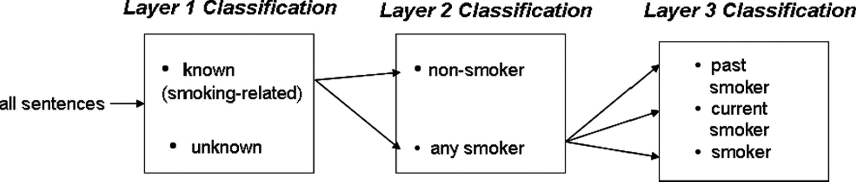
Identifying the smoking status of patients
Layer 1: Classifying Unknown and Smoking-related Sentences
Layer 2: Classifying Nonsmoker Sentences
Layer 3: Classifying Current Smoker, Past Smoker, and Smoker Sentences
Savova G K , Ogren P V , Duffy P H , et al. Mayo Clinic NLP System for Patient Smoking Status Identification[J]. Journal of the American Medical Informatics Association Jamia, 2008, 15(1):25-28.
Notes:
Li Z , Liu F , Antieau L , et al. Lancet: A high precision medication event extraction system for clinical text[J]. Journal of the American Medical Informatics Association, 2010, 17(5):563-567.

Slide 22
识别患者的吸烟状况
Layer 1: 对未知和与吸烟有关的句子进行分类
Layer 2: 对Nonsmoker句子分类
Layer 3: 对当前吸烟者，过去吸烟者和吸烟者的句子进行分类
Savova G K , Ogren P V , Duffy P H , et al. Mayo Clinic NLP System for Patient Smoking Status Identification[J]. Journal of the American Medical Informatics Association Jamia, 2008, 15(1):25-28.
Notes:
Li Z , Liu F , Antieau L , et al. Lancet: A high precision medication event extraction system for clinical text[J]. Journal of the American Medical Informatics Association, 2010, 17(5):563-567.

Slide 23
Rule based vs. Machine learning
Rule based NLP
A rule-based system uses rules as the knowledge representation.
missing learning capability
it’s tough (to nearly impossible) to add rules to an already large knowledge base without introducing contradicting rules
Machine learning NLP
Machine Learning is Based on ‘Models’.
Machine Learning Models Need to Be ‘Trained’.
In machine learning the creation of rules is largely replaced by the engineering of features.
Notes:
https://deparkes.co.uk/2017/11/24/machine-learning-vs-rules-systems/
https://www.tricentis.com/artificial-intelligence-software-testing/ai-approaches-rule-based-testing-vs-learning/

Slide 24
基于规则 vs. 机器学习
基于规则的NLP
基于规则的系统使用规则作为知识表示.
缺乏学习能力
在不引入矛盾规则的情况下向已经很大的知识库添加规则是很困难的（几乎不可能）
机器学习NLP
机器学习基于“模型”。
机器学习模型需要“训练”。
在机器学习中，规则的创建在很大程度上取决于特征的工程。
Notes:
https://deparkes.co.uk/2017/11/24/machine-learning-vs-rules-systems/
https://www.tricentis.com/artificial-intelligence-software-testing/ai-approaches-rule-based-testing-vs-learning/

Slide 25
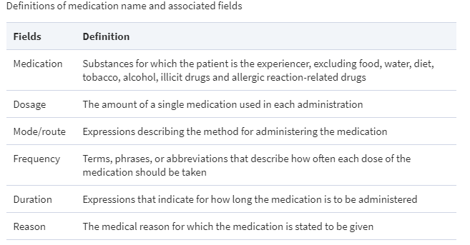
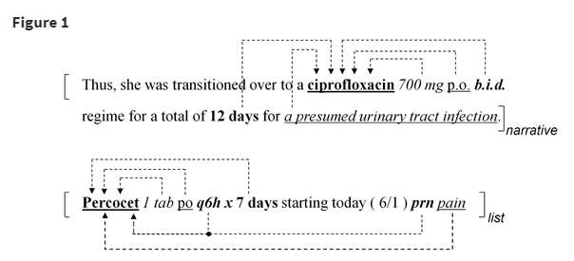
Medication event extraction
a supervised machine-learning system that automatically extracts medication events consisting of medication names and information pertaining to their prescribed use (dosage, mode, frequency, duration and reason) from lists or narrative text in medical discharge summaries.
Li Z , Liu F , Antieau L , et al. Lancet: A high precision medication event extraction system for clinical text[J]. Journal of the American Medical Informatics Association, 2010, 17(5):563-567.

Slide 26
药物事件提取
有监督的机器学习系统，从医疗出院摘要中的清单或叙述文本中自动提取由药物名称和与其规定用途（剂量，方式，频率，持续时间和原因）有关的信息组成的药物事件。
Li Z , Liu F , Antieau L , et al. Lancet: A high precision medication event extraction system for clinical text[J]. Journal of the American Medical Informatics Association, 2010, 17(5):563-567.

Slide 27
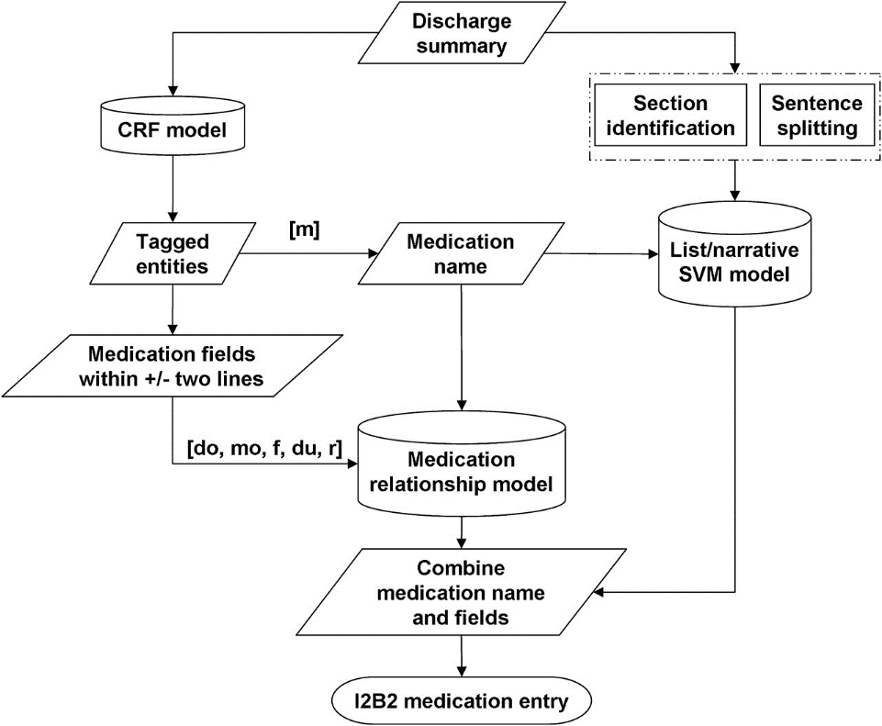
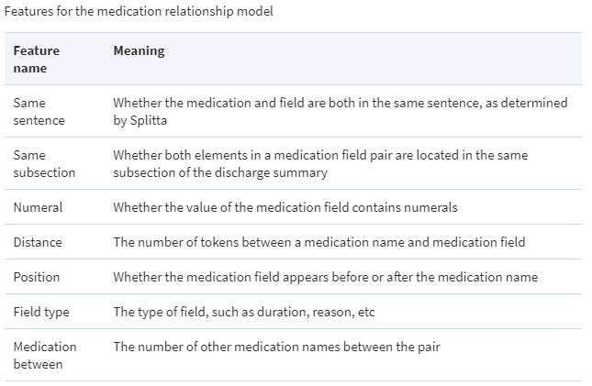
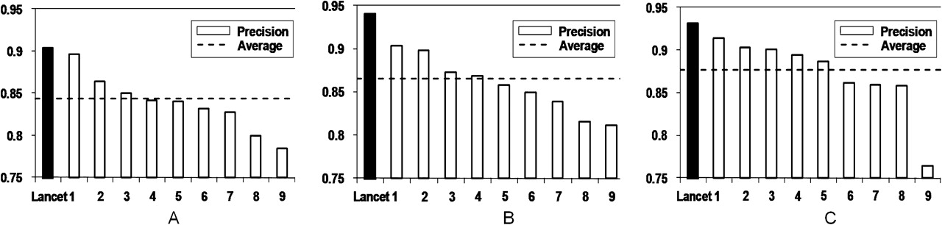
Medication event extraction
Workflow:
Feature for the medical relation model:
Results:
Li Z , Liu F , Antieau L , et al. Lancet: A high precision medication event extraction system for clinical text[J]. Journal of the American Medical Informatics Association, 2010, 17(5):563-567.

Slide 28
药物事件提取
工作流：
医学关系模型的特征：
结果：
Li Z , Liu F , Antieau L , et al. Lancet: A high precision medication event extraction system for clinical text[J]. Journal of the American Medical Informatics Association, 2010, 17(5):563-567.

Slide 29
Extraction of medications and associated adverse drug events
developed deep learning approaches for extracting medications and their attributes such as ADEs
Data Set: The n2c2 (2018) corpus included 505 discharge summaries, which came from the MIMIC-III (Medical Information Mart for Intensive Care III) clinical care database. The corpus contained 9 types of clinical concepts including drug and its 8 attributes (reason, ADE, frequency, strength, duration, route, form, and dosage). The relations between drug and the 8 attributes were also annotated. The training data set included 303 discharge summaries and the test set included 202 discharge summaries
Preprocessing: sentence boundary detection, tokenization, and POS tagging
Wei Q, Ji Z, Li Z, et al. A study of deep learning approaches for medication and adverse drug event extraction from clinical text[J]. Journal of the American Medical Informatics Association, 2019.

Slide 30
提取药物和相关的不良药物事件
开发了深度学习方法，用于提取药物及其属性，如ADE
数据集：n2c2（2018）语料库包括505个出院摘要，来自MIMIC-III（医疗信息市场的重症监护III）临床护理数据库。 语料库包含9种类型的临床概念，包括药物及其8个属性（原因，ADE，频率，强度，持续时间，途径，形式和剂量）。 药物与8种属性之间的关系也有注释。 训练数据集包括303个出院小结，测试集包括202个出院小结
预处理：句子边界检测，分词和词性标注
Wei Q, Ji Z, Li Z, et al. A study of deep learning approaches for medication and adverse drug event extraction from clinical text[J]. Journal of the American Medical Informatics Association, 2019.

Slide 31
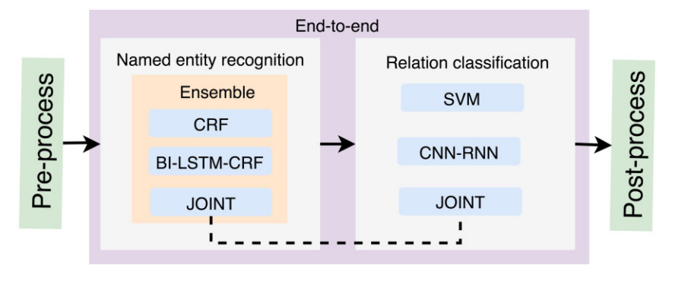
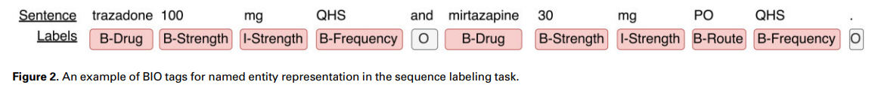
Extraction of medications and associated adverse drug events
Wei Q, Ji Z, Li Z, et al. A study of deep learning approaches for medication and adverse drug event extraction from clinical text[J]. Journal of the American Medical Informatics Association, 2019.
Notes:
The preprocessing module includes basic steps such as sentence boundary detection, tokenization, and POS tagging
Postprocessing: 1) Recover the relations for isolated nondrug entities, 2) Remove relations that spanned across sections

Slide 32
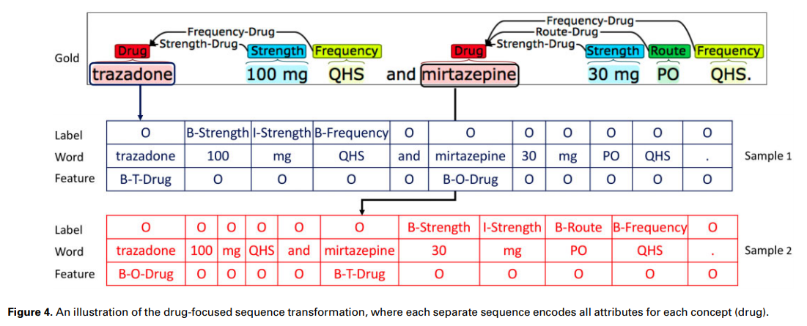
Extraction of medications and associated adverse drug events
Wei Q, Ji Z, Li Z, et al. A study of deep learning approaches for medication and adverse drug event extraction from clinical text[J]. Journal of the American Medical Informatics Association, 2019.
Notes:
The preprocessing module includes basic steps such as sentence boundary detection, tokenization, and POS tagging
Postprocessing: 1) Recover the relations for isolated nondrug entities, 2) Remove relations that spanned across sections

Slide 33
MedNLP in Chinese

Slide 34
Chinese medical natural language processing
Most NLP work on clinical has focused on text written in English.
Rapid growth of EHRs in China.
Limit work of NLP in Chinese clinical text
Huge opportunities and challenges in Chinese medical natural language processing.

Slide 35
中文医学自然语言处理
以往大多数NLP临床工作都集中在用英语写的文本上。
EHR数据在中国快速增长。
目前NLP在中国医疗文本中的工作有限
中国医学自然语言处理面临巨大机遇和挑战。

Slide 36
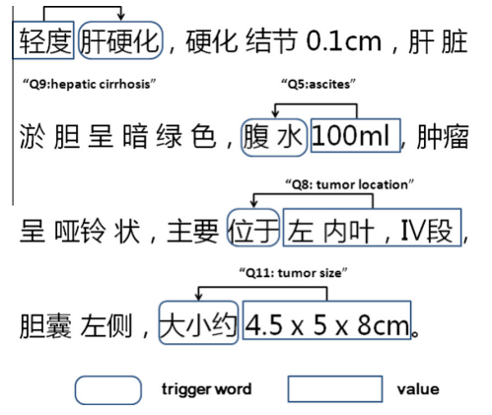
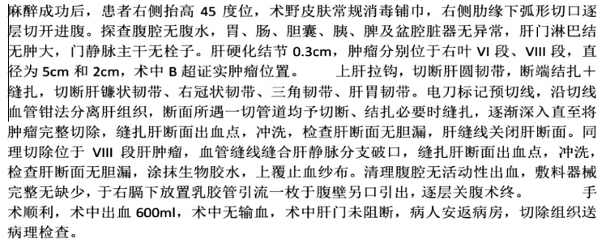
Extracting important information from Chinese operation notes
115 electronic medical records from 115 individual patients from Zhongshan Hospital
Wang H , Zhang W , Zeng Q , et al. Extracting important information from Chinese Operation Notes with natural language processing methods[J]. Journal of Biomedical Informatics, 2014, 48:130-136.

Slide 37
从中文手术记录中提取重要信息
来自中山医院115名患者的115份电子病历
Wang H , Zhang W , Zeng Q , et al. Extracting important information from Chinese Operation Notes with natural language processing methods[J]. Journal of Biomedical Informatics, 2014, 48:130-136.

Slide 38
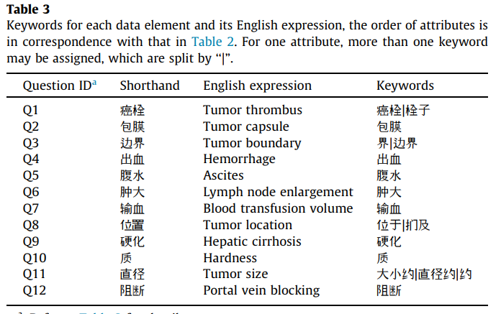
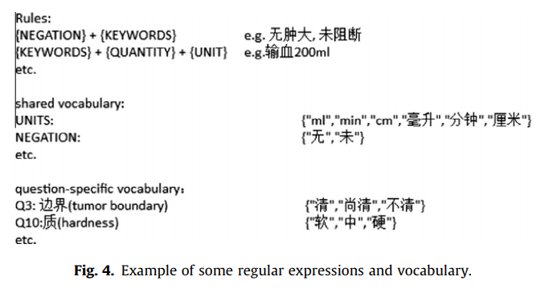
Extracting important information from Chinese operation notes
Wang H , Zhang W , Zeng Q , et al. Extracting important information from Chinese Operation Notes with natural language processing methods[J]. Journal of Biomedical Informatics, 2014, 48:130-136.

Slide 39
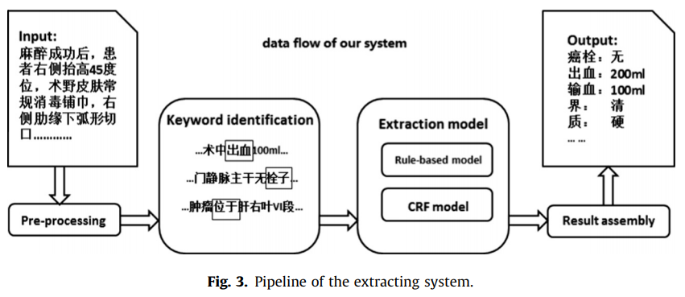
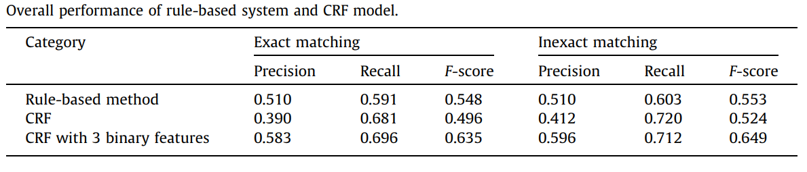
Extracting important information from Chinese operation notes
Pipeline of
information
extract
system
System performance
Wang H , Zhang W , Zeng Q , et al. Extracting important information from Chinese Operation Notes with natural language processing methods[J]. Journal of Biomedical Informatics, 2014, 48:130-136.

Slide 40
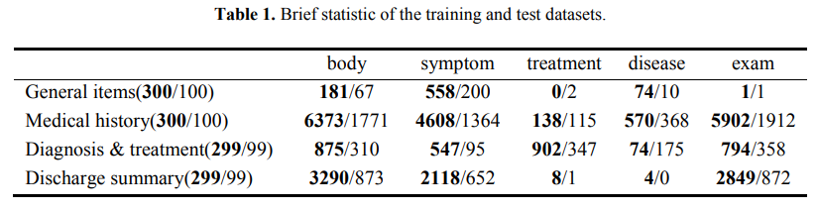
Clinical named entity recognition(NER)
Clinical named entity recognition (CNER) that identifies boundaries and types of medical entities, is a fundamental and crucial task in clinical natural language processing
Data:一般项目(general items), 病史特点(medical history), 诊疗经过(diagnosis & treatment), 出院情况(discharge summary), in which there are 5 types of clinical entities to be recognized, include 身体部位(body), 症状和体征(symptom), 疾病和诊断(disease), 检查和检验(exam) and 治疗(treatment)
E. Ouyang, Y. Li, L. Jin, Z. Li, and X. Zhang, “Exploring n-gram character presentation in bidirectional RNN-CRF for chinese clinical named entity recognition,” in CEUR Workshop Proceedings, vol. 1976, Chengdu, China, 2017, pp. 37 – 42.

Slide 41
临床命名实体识别（NER）
临床命名实体识别（CNER）识别医学实体的边界和类型，是临床自然语言处理中的基本且关键的任务
数据集:一般项目(general items), 病史特点(medical history), 诊疗经过(diagnosis & treatment), 出院情况(discharge summary), 每一类都有以下五种类别实体： 身体部位(body), 症状和体征(symptom), 疾病和诊断(disease), 检查和检验(exam) and 治疗(treatment)
E. Ouyang, Y. Li, L. Jin, Z. Li, and X. Zhang, “Exploring n-gram character presentation in bidirectional RNN-CRF for chinese clinical named entity recognition,” in CEUR Workshop Proceedings, vol. 1976, Chengdu, China, 2017, pp. 37 – 42.

Slide 42
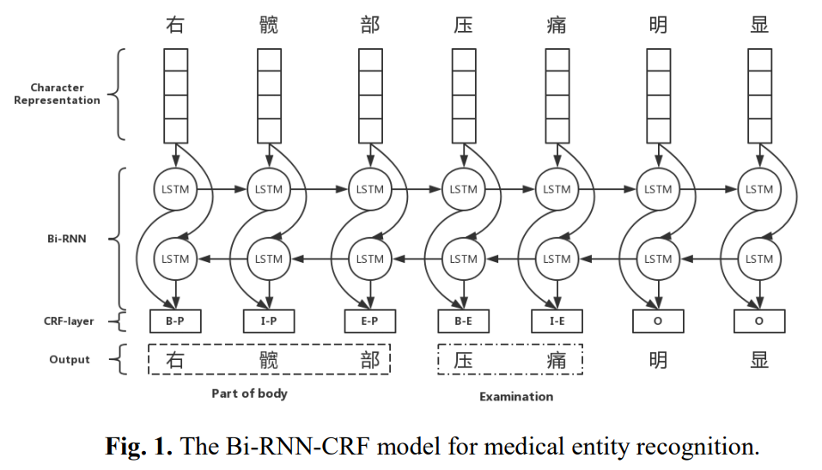
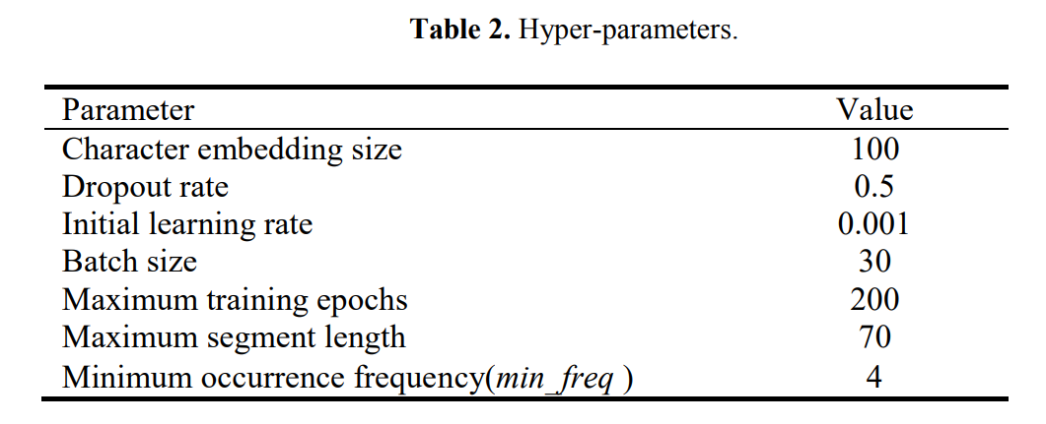
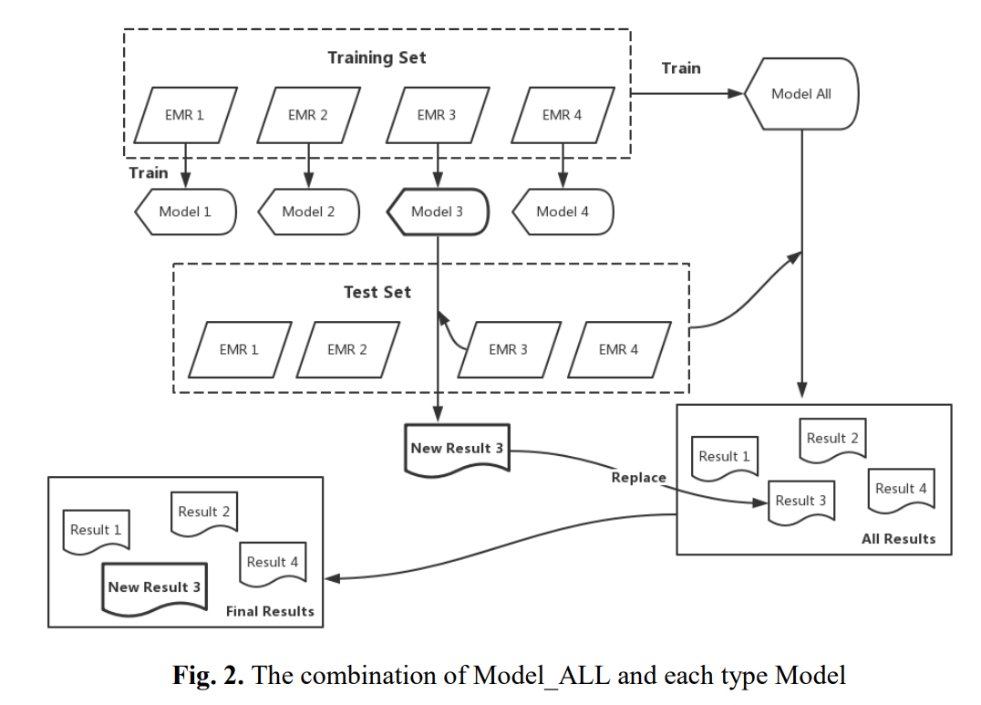
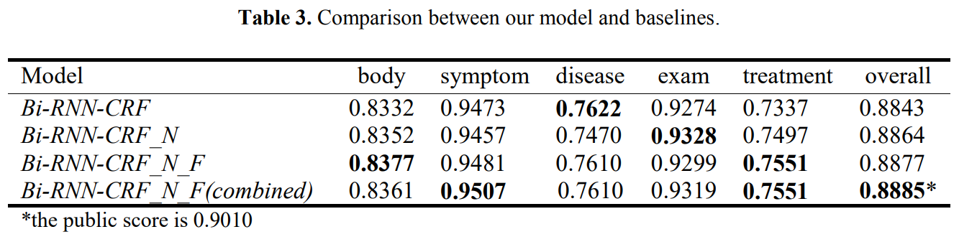
Clinical named entity recognition(NER)
E. Ouyang, Y. Li, L. Jin, Z. Li, and X. Zhang, “Exploring n-gram character presentation in bidirectional RNN-CRF for chinese clinical named entity recognition,” in CEUR Workshop Proceedings, vol. 1976, Chengdu, China, 2017, pp. 37 – 42.

Slide 43
Reference
Nadkarni P M , Ohno-Machado L , Chapman W W . Natural language processing: an introduction[J]. Journal of the American Medical Informatics Association, 2011, 18(5):544-551.
Kang N , Singh B , Afzal Z , et al. Using rule-based natural language processing to improve disease normalization in biomedical text[J]. Journal of the American Medical Informatics Association, 2013, 20(5):876-881.
Savova G K , Ogren P V , Duffy P H , et al. Mayo Clinic NLP System for Patient Smoking Status Identification[J]. Journal of the American Medical Informatics Association Jamia, 2008, 15(1):25-28.
Li Z , Liu F , Antieau L , et al. Lancet: A high precision medication event extraction system for clinical text[J]. Journal of the American Medical Informatics Association, 2010, 17(5):563-567.
Wei Q, Ji Z, Li Z, et al. A study of deep learning approaches for medication and adverse drug event extraction from clinical text[J]. Journal of the American Medical Informatics Association, 2019.
Wang H , Zhang W , Zeng Q , et al. Extracting important information from Chinese Operation Notes with natural language processing methods[J]. Journal of Biomedical Informatics, 2014, 48:130-136.
E. Ouyang, Y. Li, L. Jin, Z. Li, and X. Zhang, Exploring n-gram character presentation in bidirectional RNN-CRF for chinese clinical named entity recognition, in CEUR Workshop Proceedings, vol. 1976, Chengdu, China, 2017, pp. 37 – 42.
Lei J , Tang B , Lu X , et al. A comprehensive study of named entity recognition in Chinese clinical text[J]. Journal of the American Medical Informatics Association, 2014, 21(5):808-814.
Koleck T A, Dreisbach C, Bourne P E, et al. Natural language processing of symptoms documented in free-text narratives of electronic health records: a systematic review[J]. Journal of the American Medical Informatics Association, 2019, 26(4): 364-379.

Slide 44
Experiment

Slide 45
Experiment- medical sentence category
试验名称：中文筛选标准句子分类
来源：中文临床试验注册网站 （http://chictr.org.cn/）
特点：自由文本，非结构化，类型多样
数量：13053条
适用于：分类问题
目标：基于数据集的特点，将文本转换为特征向量，来对文本进行分类
开发工具：Anaconda3 的 Jupyter notebook
实现思路：首先观察数据，将数据按照4:1的比例分为训练集和测试集，然后通过观察数据特征，构建特征向量，使用Sklearn包的SVM算法进行训练，调用预测函数对 测试集进行预测，将结果与原始值进行比较，并评估准确度
具体操作见附件word文档！

